Slide 1
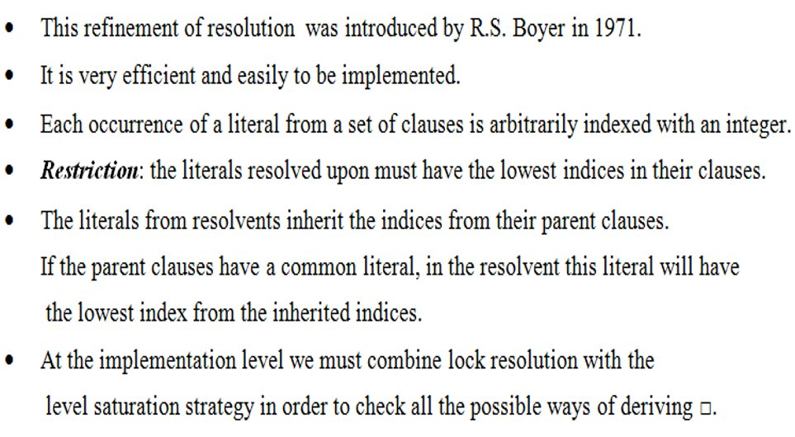
Lock resolution (Theory)

Slide 2
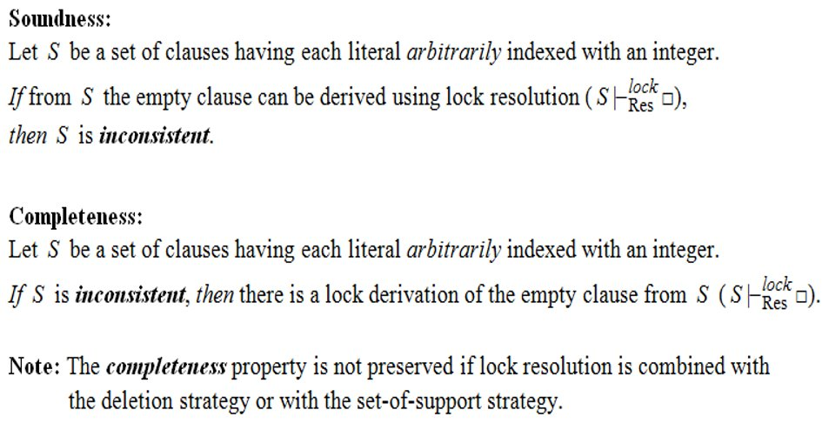
Theorems

Slide 3
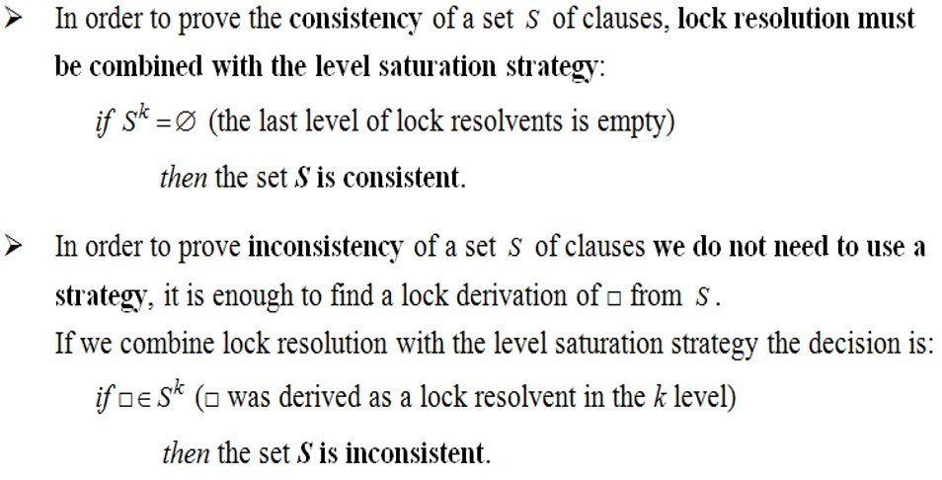
Remarks

Slide 4
7.1
Check the consistency of the following sets of clauses using lock resolution.
Choose two different indexings for the literals
S = {p v q v r, ¬q v r, ¬r v ¬p}

Slide 5
First indexing
S = {p v q v r, ¬q v r, ¬r v ¬p}
C₁ = p v q v r
C₂ = ¬q v r
C₃ = ¬r v ¬p
C₁ = ₍₁₎p v ₍₂₎q v ₍₃₎r
C₂ = ₍₄₎¬q v ₍₅₎r
C₃ = ₍₆₎¬r v ₍₇₎¬p
S⁰ = S = {C₁, C₂, C₃} - the initial set of clauses
No lock resolvents can be generated (S¹ = ∅), the empty clause cannot be derived from S, therefore the set is consistent.

Slide 6
Second indexing
C₁ = ₍₁₎p v ₍₂₎q v ₍₃₎r
C₂ = ₍₅₎¬q v ₍₄₎r
C₃ = ₍₆₎¬r v ₍₇₎¬p
S⁰ = S = {C₁, C₂, C₃} - the initial set of clauses
C₄ = Res_{r}^{lock} (C₂, C₃) = ₍₅₎¬q v ₍₇₎¬p
S² = {C₄}
No lock resolvents can be generated (S³ = ∅), the empty clause cannot be derived from S², therefore the set is consistent.

